Slide 1
APPLIED DATA SCIENCE GROUP-1
PROJECT 9:
AIR QUALITY ANALYSIS AND PREDICTION IN TAMILNADU

Slide 2
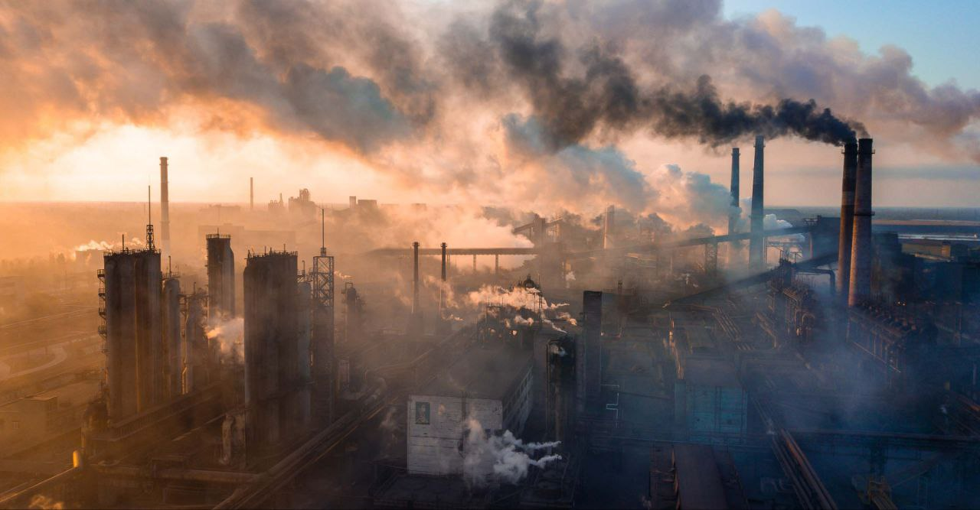
Analysing and predicting air quality in Tamil Nadu requires access real time air quality data , historical data and the use of predictive models here is general outline of the process.

Slide 3
Content:
Data Collection
Data Pre-processing
Exploratory Data Analysis (EDA )
Feature Engineering
Model Selection
Prediction
Visualization
Model Evaluation
Alert System

Slide 4
Data Collection:
Gather real-time air quality data from monitoring stations across Tamil Nadu. This data typically includes parameter like PM2.5, PM10 ,NO2, SO2, CO,O3 temperature, humidity and speed.
Data Pre-processing:
Clean and pre-process the collected data. This involves handling missing values, outliers, and ensuring data consistency.

Slide 5
Exploratory Data Analysis (EDA):
Perform EDA to understand the patterns and trends in the air quality data. Visualization techniques can help identify correlations and seasonality.
Feature Engineering:
Create relevant features that can influence air quality, such as meteorological data, traffic patterns, and industrial activities.

Slide 6
Model Selection:
Choose suitable machine learning or statistical models for air quality prediction. Time series models like ARIMA or machine learning models like Random Forests and Gradient Boosting are often used.
Prediction:
Use the trained model to make air quality predictions for specific locations in Tamil Nadu.

Slide 7
Visualization:
Visualize the predicted air quality data on maps or charts to make it more understandable to the public.
Model Evaluation:
Assess the model's performance using metrics like Mean Absolute Error (MAE), Root Mean Squared Error (RMSE), and R-squared.
Alert System:
Implement an alert system that informs the public when air quality levels reach unhealthy levels, based on the predictions.

Slide 8
Public view for problem
The objective of this project is to analyze and visualize air quality data from various monitoring stations in Tamil Nadu.
The dataset contains measurements of Sulfur Dioxide (SO2), Nitrogen Dioxide (NO2), and Respirable Suspended Particulate Matter/Particulate Matter 10 (RSPM/PM10) levels in different cities, towns, villages, and areas.
The project aims to gain insights into the air pollution trends, identify areas with high pollution levels, and create a predictive model to estimate RSPM/PM10 levels based on SO2 and NO2 levels.

Slide 9
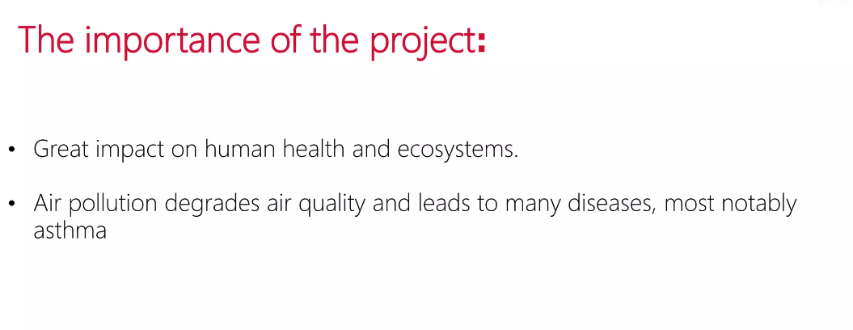
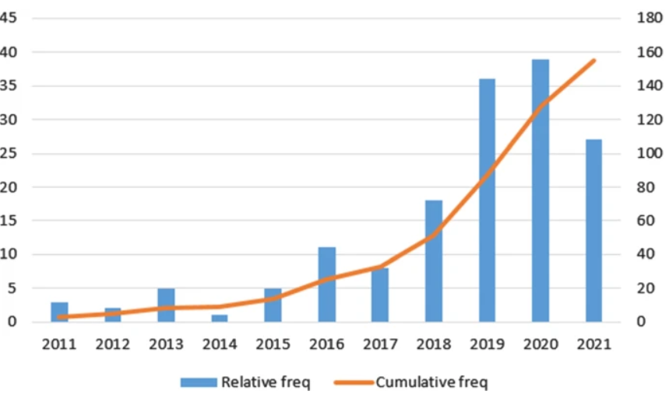

Slide 10
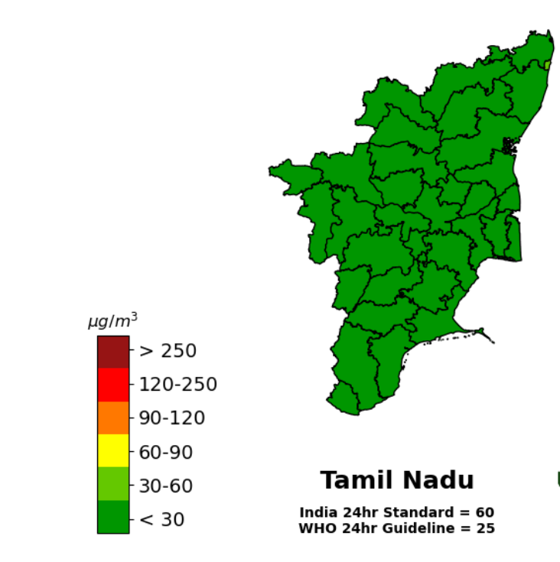
The Goal of the research
Project Objectives:
Define objectives such as analyzing air quality trends, identifying pollution hotspots, and building a predictive model for RSPM/PM10 levels.
Analysis Approach:
Plan the steps to load, preprocess, analyze, and visualize the air quality data.
Visualization Selection:
Determine visualization techniques (e.g., line charts, heatmaps) to effectively represent air quality trends and pollution levels.

Slide 11
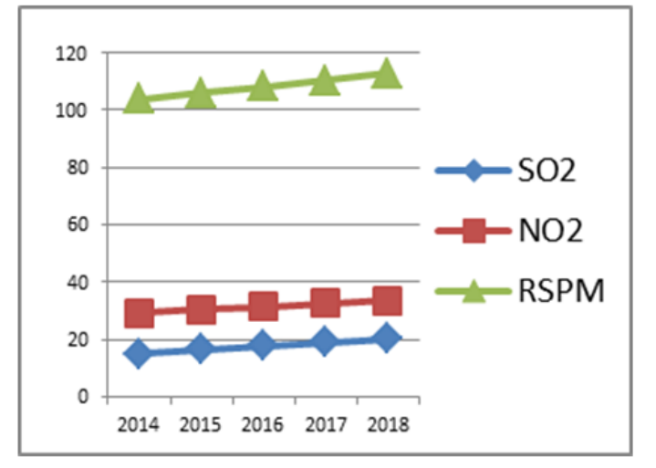
Methods used to predict
Chemical transport model(CTMs)
Statistical model
Weather model
Time series analysis
Ensemble model

Slide 12
Python code
import pandas as pd import numpy as np from sklearn.model_selection import train_test_split from sklearn.linear_model import LinearRegression import matplotlib.pyplot as plt np.random.seed(0) dates = pd.date_range(start="2014-01-01", end="2014-12-31", freq="D") pm10_levels = np.random.randint(10, 100, len(dates)) temperature = np.random.randint(25, 35, len(dates)) humidity = np.random.randint(40, 70, len(dates))
data = pd.DataFrame({"Date": dates, "PM10": pm10_levels, "Temperature": temperature, "Humidity": humidity})

Slide 13
X = data[["Temperature", "Humidity"]] y = data["PM10"] X_train, X_test, y_train, y_test = train_test_split(X, y, test_size=0.2, random_state=42)
model = LinearRegression() model.fit(X_train, y_train) y_pred = model.predict(X_test) from sklearn.metrics import mean_squared_error, r2_score mse = mean_squared_error(y_test, y_pred) r2 = r2_score(y_test, y_pred) print("Mean Squared Error:", mse) print("R-squared:", r2) plt.scatter(y_test, y_pred)
plt.xlabel("Actual PM10 Levels") plt.ylabel("Predicted PM10 Levels") plt.title("Actual vs. Predicted PM10 Levels") plt.show()

Slide 14
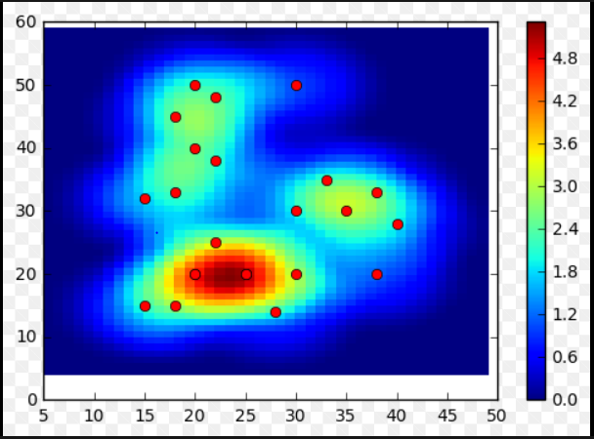
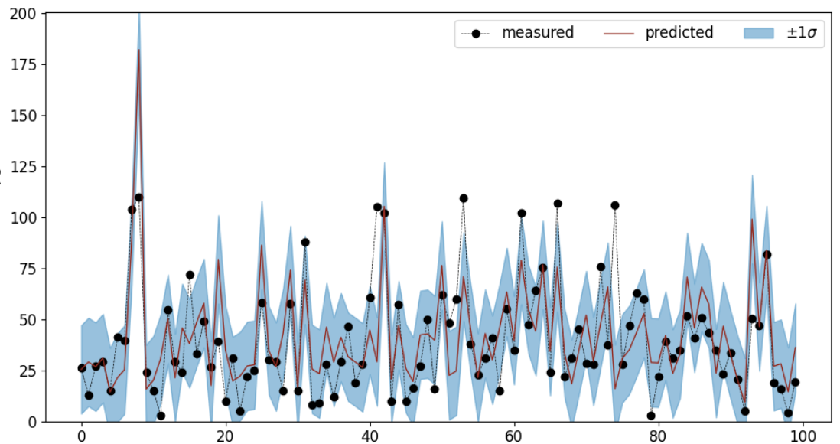
Result and Conclusion

Slide 15
Conclusion:
It's important to note that air quality prediction is a complex task influenced by various factors, including weather, pollution sources, and geographical features. Therefore, a robust and accurate model requires ongoing maintenance and improvement.
From-
N. Noorul Majhar

